Slide 1
Democratizing AI with Apache Spark
Ali Ghodsi Co-Founder and CEO

Slide 2

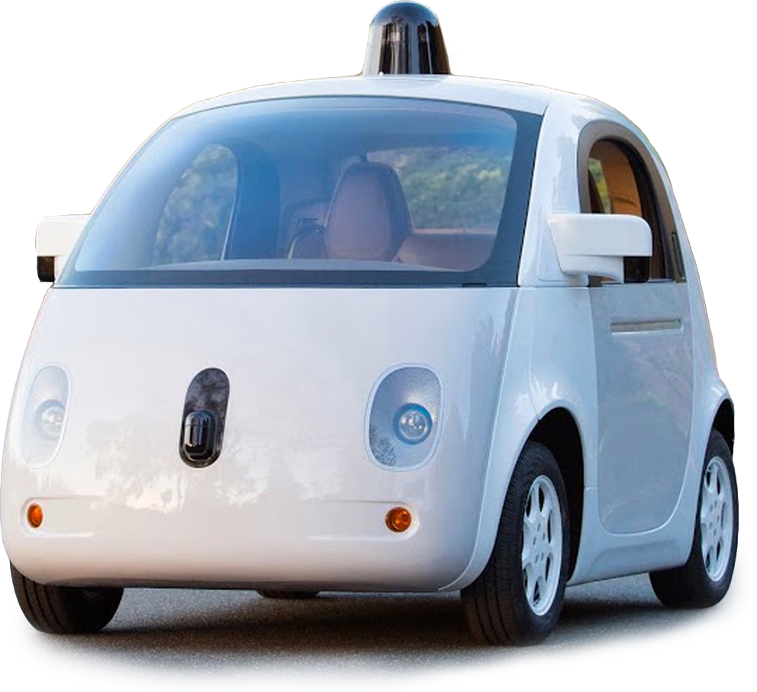
AI is changing the world
Self-driving cars
SIRI/assistants
AlphaGo
Why now?
Notes:
THIS IS NOT JUST SCI-FI

Slide 3
Data is the catalyst
Better training, tuning, validation
More data
Clickstreams
Sensor data (IoT)
Video
Speech
Handwriting
…
AI hasn’t been democratized

Slide 4
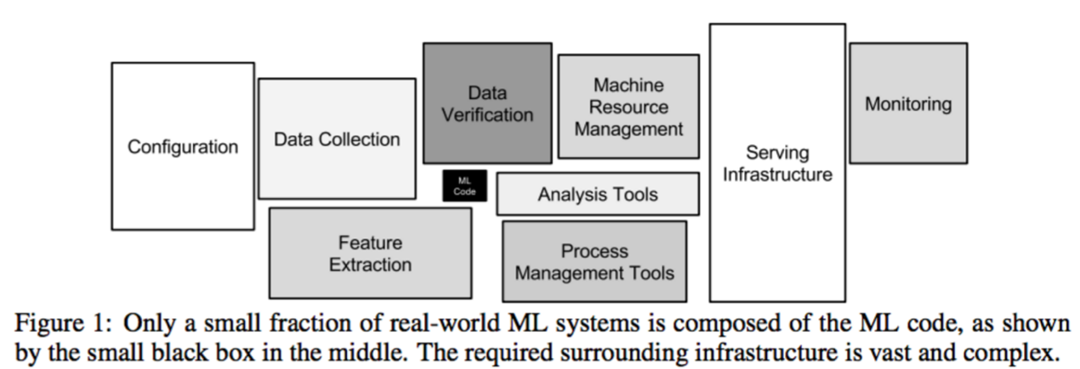
The hardest part of AI isn’t AI
“Hidden Technical Debt in Machine Learning Systems “, Google NIPS 2015
How do we democratize AI?

Slide 5


+ AI
“Hidden Technical Debt in Machine Learning Systems “, Google NIPS 2015
FLEXIBLE
FAST
BIG DATA
Notes:
BUT SPARK DOESN’T GET YOU ALL THE WAY THERE

Slide 6
Some gaps remain
Manage Data infrastructure
Create, configure, monitor resilient big data clusters.
Securely access silos of disparate data sources.
Enforce proper data governance.
1
Empower teams to be productive
2
Interactively explore data and prototype ideas.
Securely share big data clusters among analysts.
Debug, troubleshoot, version-control big data applications.
Establish Production- Ready Applications
3
Setup robust ML data pipelines for ETL/ELT.
Productionize real-time applications with HA, FT.
Build, serve, maintain advanced machine learning models.

Slide 7
Databricks: Closing the gap
Just-in-Time Data Platform
Integrated Workspace
Automated Spark Management
1
2
3
Separate compute & storage
Integrate existing data stores
Efficient cache on first access
Interactive notebooks, dashboards, reports
Real-time exploration, machine learning, graph use cases
Workflow scheduler for ML, streaming, SQL, ETL
Performance-optimized, high availability, fault-tolerant
Agile + Low TCO
Accelerate Time to Value
Performance
Notes:
1: Global publisher Elsevier – team in US and EU perform natural language processing on all their content to experiment with new product ideas.
2: Energy analytics company DNV GL – Databricks sped up analytics of IoT data from weather and grid sensor by 100x.
3: Financial service provider LendUp– Databricks enabled them to update their machine models daily instead of weekly.

Slide 8

Enterprise AI use-cases
Predict credit score, credit limit, anomalies
Predict energy demand based on massive weather data
Natural language processing to extract author graph
Predict player churn, predicting network outages
Predict machine equipment failure
Notes:
TRANSITION TO NEXT: A NEW USE CASE COMPANIES HAVE BEEN ASKING FOR

Slide 9
New Frontier of AI: Deep Learning
Detect cancer
Understand speech
Infer location
Improve cancer detection
Recognize Mandarin and English
Identify landmarks in photos
Notes:
THERE IS A LOT OF INTEREST IN DEEP LEARNING, THE MACHINE LEARNING TECHNIQUE THAT HAS ACHIEVED REMARKABLE RESULTS
** PICTURE IS BRUSSELS **

Slide 10
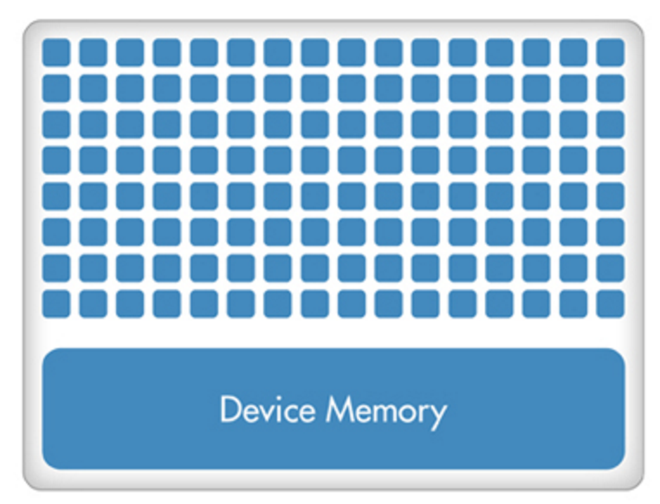
Faster and easier deep learning with Databricks
GPUs
TensorFlow on
TensorFlow: The most popular deep learning framework.
TensorFrames: Makes TensorFlow computations faster and easier to program on Spark.
Massive parallelism
TensorFrames and GPUs support out-of-the-box
Notes:
IN RESPONSE TO THE GROWING DEMAND FOR DEEP LEARNING ON SPARK FROM THE COMMUNITY, DATABRICKS HAS BEEN WORKING HARD, AND IS PROUD TO ANNOUNCE TODAY THAT…

Slide 11
Deep Learning on Databricks
Clusters
Data Ingest
Feature extraction
Model Training
Product-ionize
Automated management
Just-in-time data platform
Interactive exploration
TensorFrames
+
GPUs
Jobs & Workflows
Notes:
In summary, Databricks mission has always been to make big data simple.
With the new developments we are taking a next step in this journey,
DEMOCRATIZING DEEP LEARNING by making it simple for all

Slide 12
Thank you.

Slide 13
Deep Learning references
Image recognition (Geo ID):
https://www.technologyreview.com/s/600889/google-unveils-neural-network-with-superhuman-ability-to-determine-the-location-of-almost/
Cancer screening:
http://www.popsci.com/how-deep-learning-technology-could-be-next-step-in-cancer-detection
https://blogs.nvidia.com/blog/2016/09/19/deep-learning-breast-cancer-diagnosis/
Speech translation:
https://www.technologyreview.com/s/544651/baidus-deep-learning-system-rivals-people-at-speech-recognition/

Slide 14
Databricks
Spark Enterprise Platform
Cloud-hosted data platform based on Spark
Develop Spark, shepherd community, evangelize Spark
75% of Spark written by Databricks, 10x more than others
Strategic Support
Only company that can make customer’s with data problems successful
Deep Spark Training
Trained 20,000 in 2015 – MOOCs, on-site training, SPOCs
Notes:
WHY DID WE START DATABRICKS?
THIS IS WHERE THE WORLD IS GOING

Slide 15



Analytics Transforming Industries
PHARMA
MEDIA
INDUSTRIAL
Predicting Diabetes in Rural Counties
Next-Gen Product R&D
Generating programs based on Nielsen ratings
Predictive Analytics
Real-time detection of failing wind-turbines
Anomaly Detection
Real-time Data-Driven Analytics Applications

Slide 16

Databricks Just-in-Time Data Platform
Powered by Apache Spark
Integrated Workspace
BI Tools
Your Custom Spark Apps
DASHBOARDS
Reports
NOTEBOOKS
github, viz, collaboration
PRODUCTION JOBS
Orchestrated Spark In The Cloud
Open Source
Databricks Managed Services
+
Enterprise Security
Access Control, Auditing, Encryption
Clusters: Auto-scaled, resilient, multi-tenant
Data Integration: Universal secure and fast
Interfaces: BI tools & REST API
Your Storage
Cloud Storage
Data Warehouses
Hadoop / Data Lakes
Notes:
The DatabricksEnterprise Spark Platform
Built by the creators of Spark
Contribute 75% of the code
Trained 20,000+ users
Largest # of customers deploying Spark
Spark is becoming the de facto standard for big data
Started at UC Berkeley AMPLab in 2009
Most active open source project in data processing (1000+ contributors)
Today, the de facto technology standard for big data processing is Apache Spark. Spark is an open source data processing framework that was built for speed, ease of use, and scale.
It has been adopted by thousands of companies for every type of workload because it solves some of the most pressing data challenges:
Ability to process a wide variety of data types.
Unlimited scalability, for organizations with rapidly growing data.
Flexible enough to be customized for many use cases and with a wide variety of programming languages.
Databricks was founded by the creators Apache Spark. In addition to creating Spark, we continue to be the driving force behind Spark contributing over 75% of the code every release. (10X more than any other vendor); trained 20K Spark users on Databricks (more users trained than any other vendor) and has the largest number of customers deploying Spark (>200)…more than any other vendor.
Additional info on Spark if required: Much of its benefits are due to how it unifies critical data analytics capabilities such as SQL, machine learning and streaming in a single framework. This enables enterprises to simultaneously achieve high performance computing at scale while simplifying their data processing infrastructure by avoiding the difficult integration of many disparate and difficult tools with a single powerful yet simple alternative.

Slide 17


Databricks Just-in-Time Data Platform
Powered by Apache Spark
Integrated Workspace
BI Tools
Your Custom Spark Apps
Dashboards
Reports
Notebooks
github, viz, collaboration
Production Jobs
Orchestrated Spark In The Cloud
Open Source
Clusters: Auto-scaled, resilient, multi-tenant
Data Integration: Universal secure and fast
Interfaces: BI tools & REST API
+
Managed Services
Your Storage
YOUR STORAGE
Cloud Storage
Data Warehouses
Hadoop / Data Lakes
Enterprise Security
Access Control, Auditing, Encryption
Notes:
The DatabricksEnterprise Spark Platform
Built by the creators of Spark
Contribute 75% of the code
Trained 20,000+ users
Largest # of customers deploying Spark
Spark is becoming the de facto standard for big data
Started at UC Berkeley AMPLab in 2009
Most active open source project in data processing (1000+ contributors)
Today, the de facto technology standard for big data processing is Apache Spark. Spark is an open source data processing framework that was built for speed, ease of use, and scale.
It has been adopted by thousands of companies for every type of workload because it solves some of the most pressing data challenges:
Ability to process a wide variety of data types.
Unlimited scalability, for organizations with rapidly growing data.
Flexible enough to be customized for many use cases and with a wide variety of programming languages.
Databricks was founded by the creators Apache Spark. In addition to creating Spark, we continue to be the driving force behind Spark contributing over 75% of the code every release. (10X more than any other vendor); trained 20K Spark users on Databricks (more users trained than any other vendor) and has the largest number of customers deploying Spark (>200)…more than any other vendor.
Additional info on Spark if required: Much of its benefits are due to how it unifies critical data analytics capabilities such as SQL, machine learning and streaming in a single framework. This enables enterprises to simultaneously achieve high performance computing at scale while simplifying their data processing infrastructure by avoiding the difficult integration of many disparate and difficult tools with a single powerful yet simple alternative.

Slide 18




Today’s Data Reality
Cloud Storage
Data Warehouses
Hadoop / Data Lakes
Siloed, Unstructured, Fast-Growing Data

Slide 19
Databricks Just-in-Time Data Platform
OPTIONAL
Powered by Apache Spark
®
™
Integrated Workspace
BI Tools
Your Custom Spark Apps
Notebooks Dashboards
Production Jobs
Orchestrated Apache® Spark™ in the Cloud
+
Open Source
Managed Services
Your Storage
Cloud Storage | Data Warehouses | Data Lakes
Integrated Enterprise Security Framework
Notes:
The DatabricksEnterprise Spark Platform
Built by the creators of Spark
Contribute 75% of the code
Trained 20,000+ users
Largest # of customers deploying Spark
Spark is becoming the de facto standard for big data
Started at UC Berkeley AMPLab in 2009
Most active open source project in data processing (1000+ contributors)
Today, the de facto technology standard for big data processing is Apache Spark. Spark is an open source data processing framework that was built for speed, ease of use, and scale.
It has been adopted by thousands of companies for every type of workload because it solves some of the most pressing data challenges:
Ability to process a wide variety of data types.
Unlimited scalability, for organizations with rapidly growing data.
Flexible enough to be customized for many use cases and with a wide variety of programming languages.
Databricks was founded by the creators Apache Spark. In addition to creating Spark, we continue to be the driving force behind Spark contributing over 75% of the code every release. (10X more than any other vendor); trained 20K Spark users on Databricks (more users trained than any other vendor) and has the largest number of customers deploying Spark (>200)…more than any other vendor.
Additional info on Spark if required: Much of its benefits are due to how it unifies critical data analytics capabilities such as SQL, machine learning and streaming in a single framework. This enables enterprises to simultaneously achieve high performance computing at scale while simplifying their data processing infrastructure by avoiding the difficult integration of many disparate and difficult tools with a single powerful yet simple alternative.

